Slide 1
CENTRAL PROCESSING UNIT
Introduction
General Register Organization
Stack Organization
Instruction Formats
Addressing Modes
Data Transfer and Manipulation
Program Control
Reduced Instruction Set Computer (RISC)

Slide 2
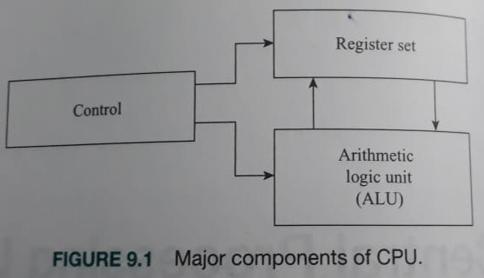
Components of CPU

Slide 3
GENERAL REGISTER ORGANIZATION
Clock
Input
R1
R2
R3
R4
R5
R6
R7
Load
(7 lines)
{
MUX
MUX
}
SELB
SELA
3 x 8
A bus
B bus
decoder
SELD
ALU
OPR
Output

Slide 4
OPERATION OF CONTROL UNIT
The control unit directs the information flow through ALU by:
- Selecting various Components in the system
- Selecting the Function of ALU
Example: R1 <- R2 + R3
[1] MUX A selector (SELA): BUS A ← R2
[2] MUX B selector (SELB): BUS B ← R3
[3] ALU operation selector (OPR): ALU to ADD
[4] Decoder destination selector (SELD): R1 ← Out Bus
3
3
3
5
Control Word
SELA
SELB
SELD
OPR
Encoding of register selection fields
Binary
Code SELA SELB SELD
000 Input Input None
001 R1 R1 R1
010 R2 R2 R2
011 R3 R3 R3
100 R4 R4 R4
101 R5 R5 R5
110 R6 R6 R6
111 R7 R7 R7

Slide 5
ALU CONTROL
Control
Encoding of ALU operations
OPR
Select Operation Symbol
00000 Transfer A TSFA
00001 Increment A INCA
00010 ADD A + B ADD
00101 Subtract A - B SUB
00110 Decrement A DECA
01000 AND A and B AND
01010 OR A and B OR
01100 XOR A and B XOR
01110 Complement A COMA
10000 Shift right A SHRA
11000 Shift left A SHLA
Examples of ALU Microoperations
Symbolic Designation
Microoperation SELA SELB SELD OPR Control Word
R1 ← R2 - R3 R2 R3 R1 SUB 010 011 001 00101
R4 ← R4 ∨ R5 R4 R5 R4 OR 100 101 100 01010
R6 ← R6 + 1 R6 - R6 INCA 110 000 110 00001
R7 ← R1 R1 - R7 TSFA 001 000 111 00000
Output ← R2 R2 - None TSFA 010 000 000 00000
Output ← Input Input - None TSFA 000 000 000 00000
R4 ← shl R4 R4 - R4 SHLA 100 000 100 11000
R5 ← 0 R5 R5 R5 XOR 101 101 101 01100

Slide 6
ALU CONTROL
Control
Encoding of ALU operations
OPR
Select Operation Symbol
00000 Transfer A TSFA
00001 Increment A INCA
00010 ADD A + B ADD
00101 Subtract A - B SUB
00110 Decrement A DECA
01000 AND A and B AND
01010 OR A and B OR
01100 XOR A and B XOR
01110 Complement A COMA
10000 Shift right A SHRA
11000 Shift left A SHLA
Examples of ALU Microoperations
Symbolic Designation
Microoperation SELA SELB SELD OPR Control Word
R1 ← R2 + R3
R4 ← R4
R5 ← R5 - 1
R6 ← Shl R1
R7 ← Input

Slide 7
ALU CONTROL
Control
Encoding of ALU operations
OPR
Select Operation Symbol
00000 Transfer A TSFA
00001 Increment A INCA
00010 ADD A + B ADD
00101 Subtract A - B SUB
00110 Decrement A DECA
01000 AND A and B AND
01010 OR A and B OR
01100 XOR A and B XOR
01110 Complement A COMA
10000 Shift right A SHRA
11000 Shift left A SHLA
Examples of ALU Microoperations
Symbolic Designation
Microoperation SELA SELB SELD OPR Control Word
R1 ← R2 + R3 R2 R3 R1 ADD
R4 ← R4 R4 - R4 TSFA
R5 ← R5 - 1 R5 - R5 DECA
R7 ← R1 R1 - R7 TSFA
Output ← R2 R2 - None TSFA

